Slide 1
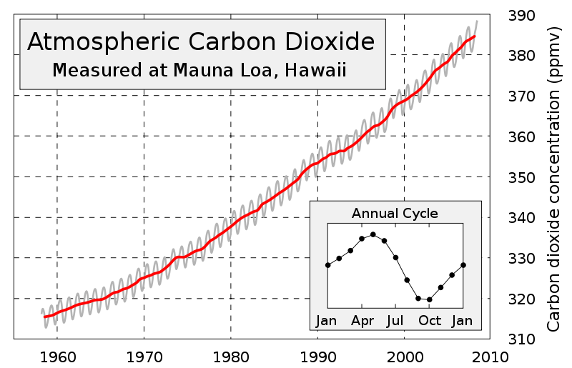
Lesson 2 Activity 4
Notes:
This is a famous graph called the Keeling Curve. A scientist named Charles Keeling originally created this graph. Starting in the 1950s, Keeling studied levels of carbon dioxide in the atmosphere at Mauna Loa scientific observatory in Hawaii. Because it is located on an island in the middle of the Pacific Ocean, Mauna Loa is a great place to sample CO₂ in the atmosphere. The annual average CO₂ that is measured represents the entire globe, but Hawaii is located about 1300 miles north of the equator, and is thus also influenced by seasonal patterns of the Northern Hemisphere.

Slide 2
What are fossil fuels?
Driving question

Slide 3
Examples of fossil fuels
natural gas
coal
Gasoline (which comes from oil/petroleum)
Notes:
What is a fossil fuel?
Why do they call it a “fossil fuel”?
Where do they come from?

Slide 4
Is gasoline organic or inorganic?
ZOOMING INTO FOSSIL FUELS

Slide 5
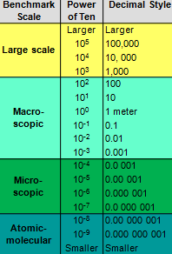
What we see… Macroscopic Scale
GASOLINE

Slide 6
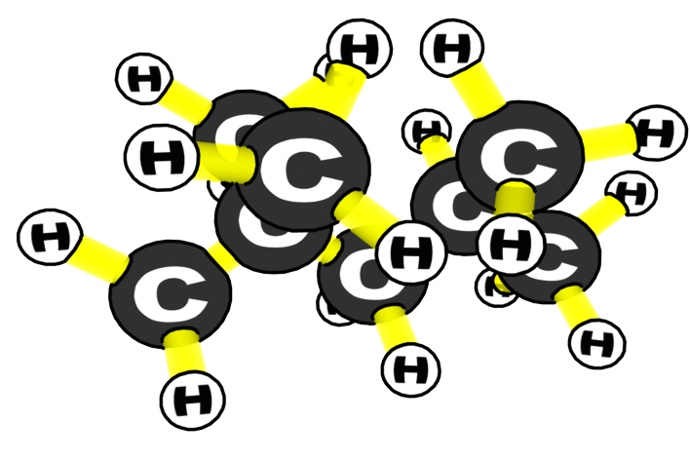
Zooming in… Atomic-molecular Scale
Gasoline (C8H18)

Slide 7
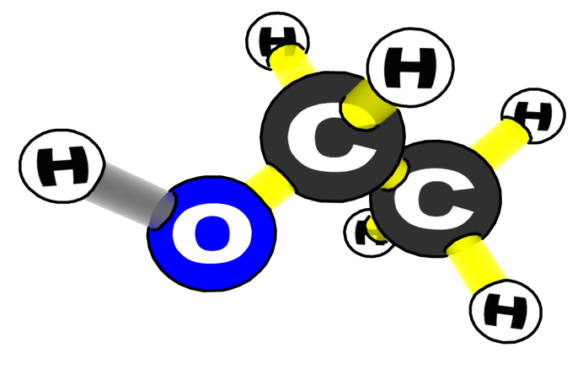
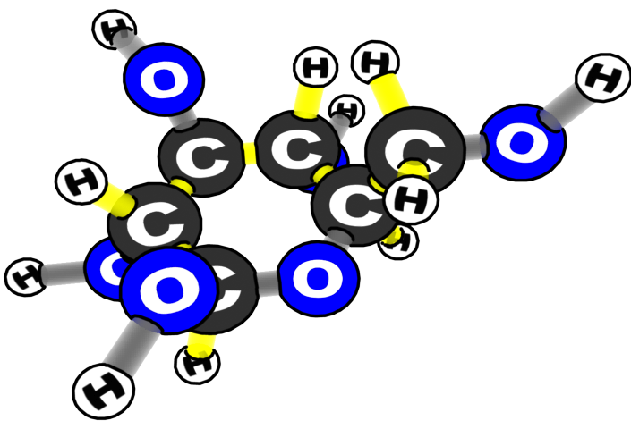
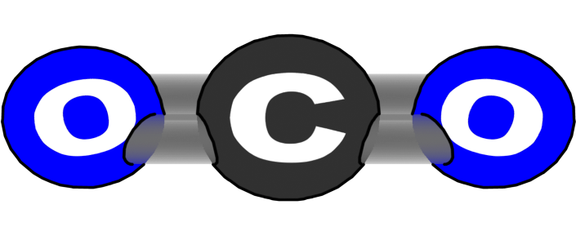
What is gasoline most similar to in terms of atoms?
Gasoline (C8H18)
Ethanol molecule (C2H6O)
Water molecule (H2O)
Carbon dioxide (CO2)
Glucose (C6H12O6)

Slide 8
What is gasoline most similar to in terms of bonds?
Gasoline (C8H18)
Ethanol molecule (C2H6O)
Water molecule (H2O)
Carbon dioxide (CO2)
Glucose (C6H12O6)

Slide 9
ORGANIC
Which group would gasoline fit into?
INORGANIC
--means the molecule is CARBON-BASED
--and the molecule has
C-C and C-H bonds
--means the molecule is not CARBON-BASED
--and the molecule does not have C-C and C-H bonds
Notes:
Note that CO2 is a linear molecule: O=C=O.

Slide 10
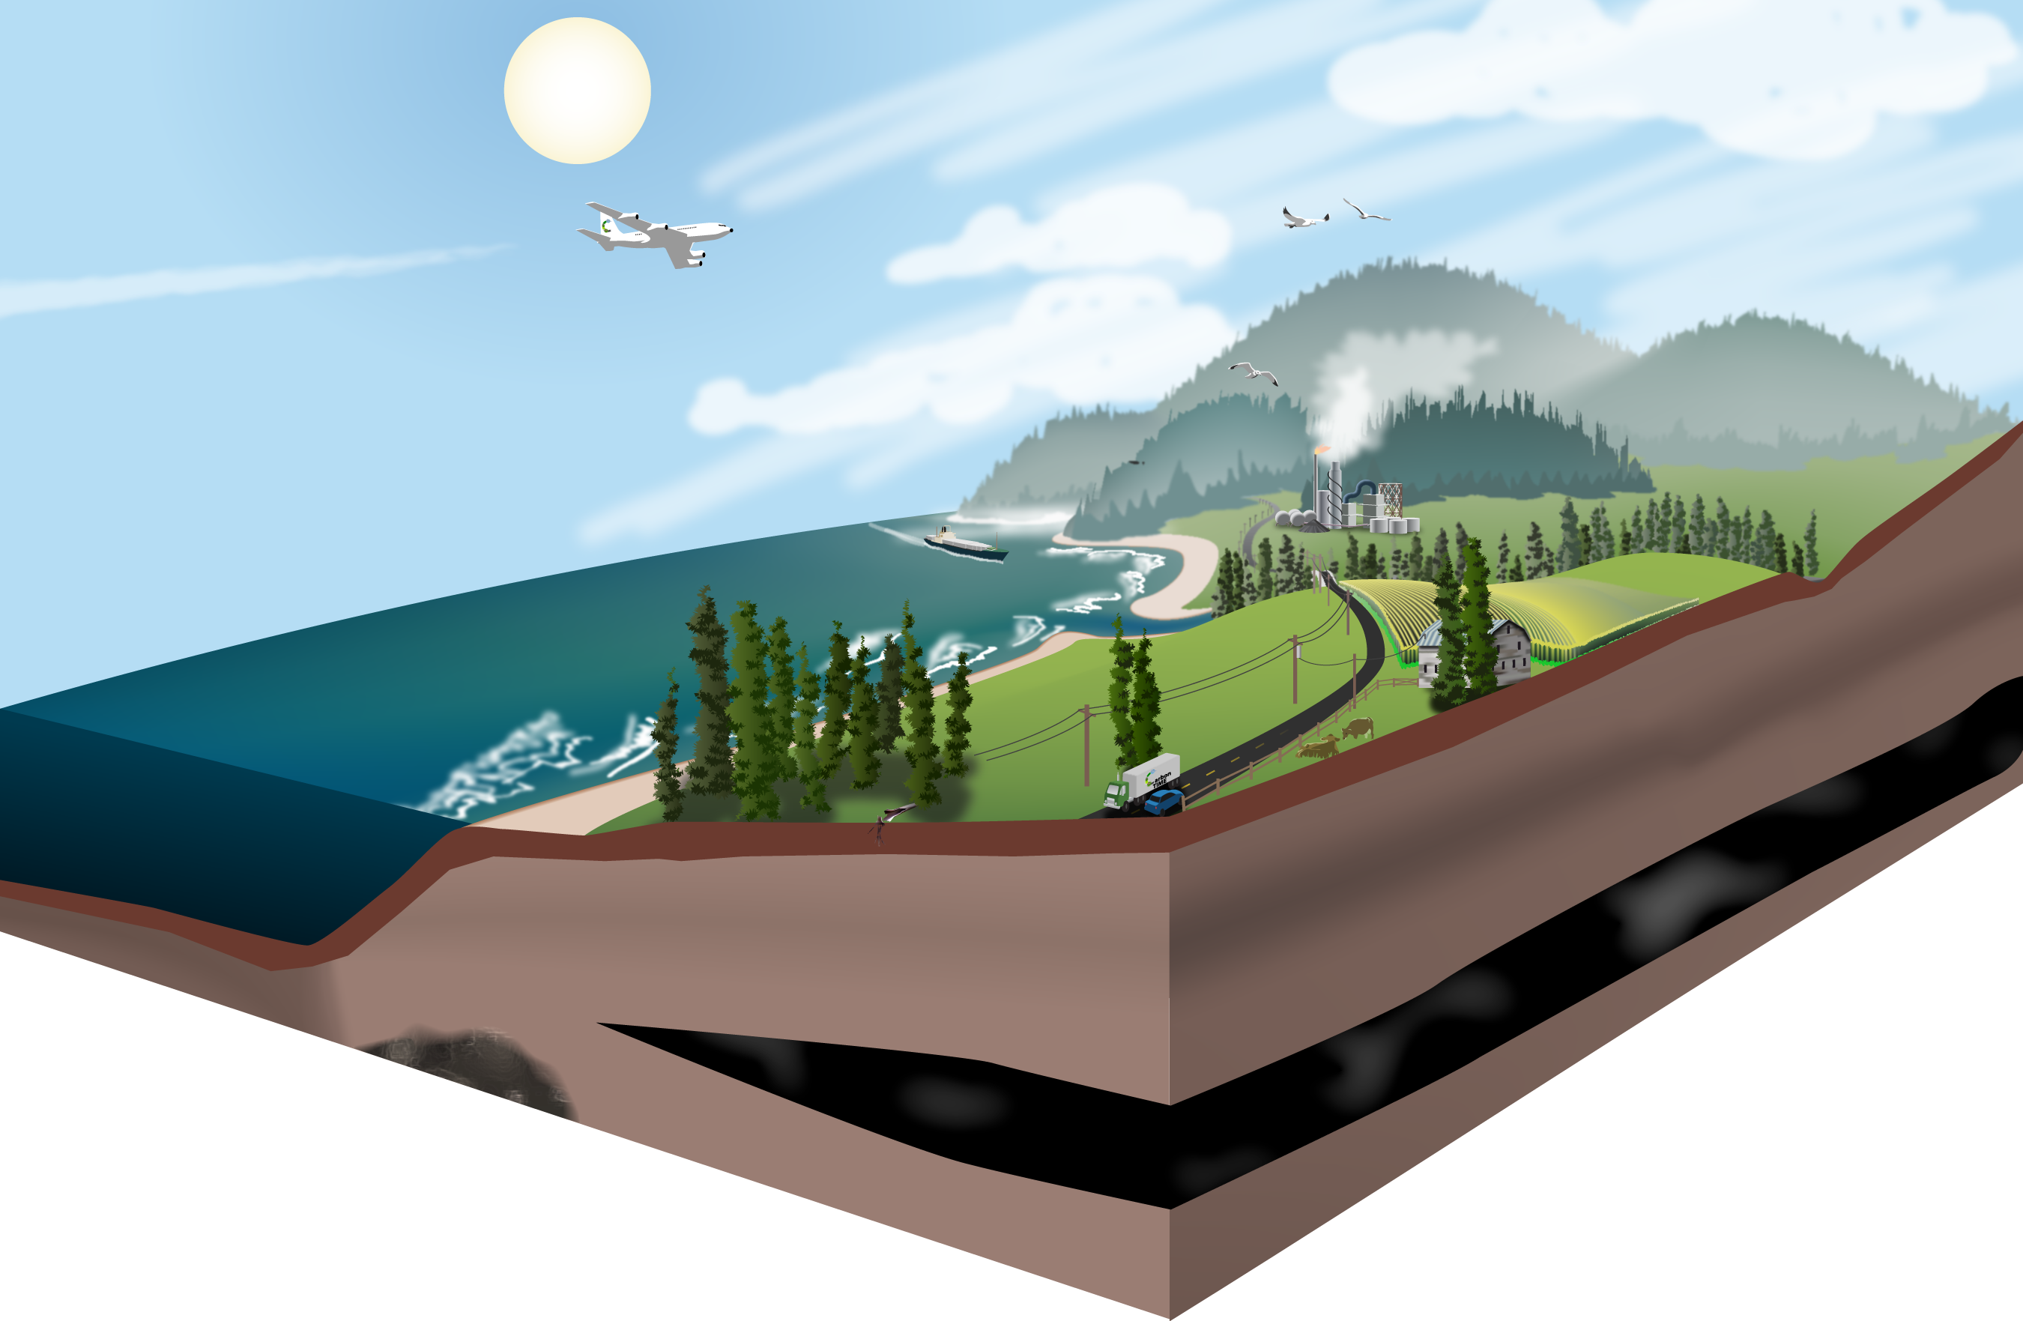
3. The Energy Question
Where is the chemical energy in this picture?
Notes:
Remember the rules: energy lasts forever!

Slide 11
3. The Energy Question
Where does the chemical energy stored in fossil fuels come from in this picture?
Notes:
Make the point here that chemical energy is important to us because it is the only form of energy that we can transport from one place to another when it is stored in materials. How is chemical energy transported?

Slide 12
3. The Energy Question
How is energy transformed when we burn fossil fuels?
Notes:
Remember the rules: energy lasts forever!

Slide 13
3. The Energy Question
Where does the energy go after we burn fossil fuels?
Notes:
Energy

